Slide 1
We Can't Just Go Shooting Asteroids Like Space Cowboys: Teaching and Learning with Immersive, Interactive Projection
Vanessa Svihla¹, Nicholas Kvam¹, Jeffrey Bowles¹, Joe Kniss¹, & Matthew Dahlgren²
¹University of New Mexico;
²Basis Charter School, Phoenix
6/13/2013
Notes:
12 min

Slide 2
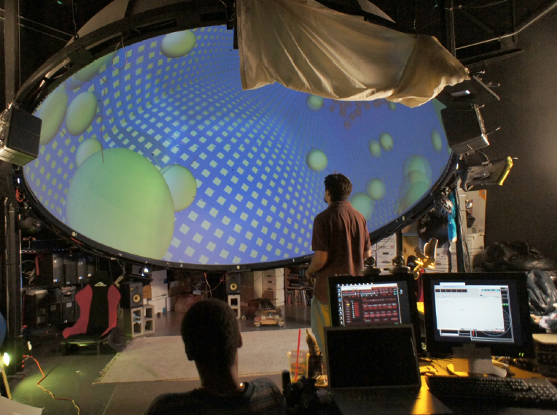
Notes:
V:
Like a small planetarium, our dome has a 15-foot diameter and provides an immersive field of view. The dome provides a backdrop for interactive, collaborative learning.

Slide 3
Immersive displays > standard desktop displays
factual recall and conceptual learning:
environmental science (Schloss, Jacobson, Handron, & Hampshire)
earth science (Sumners, Reiff, & Weber, 2008)
architecture (Jacobson, 2010)
chemical reactions (Limniou, Roberts, & Papadopoulos, 2008)
Mayan culture and astronomy (Heimlich, Sickler, Yocco, & Storksdieck, 2010)
mental rotation skills (Ganskop, 2010)
Notes:
Although somewhat limited, recent research has found fairly consistent benefits for learning with immersive media.

Slide 4
DomeGL = real-time interactivity
developed an OpenGL software platform
real-time rendering for multiple projectors displaying in dome environments without distortion
opens up new possibilities for learning
(Emmart, 2005; Wyatt, 2005)
Notes:
In a traditional planetarium, each of the 6 projectors is run by its own computer, and all the computers are networked and driven by a 7th computer. Our team devised a way to run all 6 projectors with one computer, and this is a game changer. It allows for multi-user interactivity. Our vision is to create affordable classroom versions that could be used in the corner of a classroom, transporting students to the rings of Saturn or to a carbon nanotube.

Slide 5
Role-play
learn science practices
(Solomon, Duveen, Scot, & McCarthy, 1992; Barab et al., 2010; Hickey, Barab, Ingram-Goble, & Zuiker, 2008)
develop identities as scientists
(Barab, Thomas, Dodge, Carteaux, & Tuzun, 2005; Clarke & Dede, 2005; Dawley & Dede; Dunleavy, Dede, & Mitchell, 2009; Mikropoulos & Natsis, 2011)
mediator between virtual and real identities
(Gee, 2003)
engaging students previously uninterested
(Dunleavy et al., 2009)

Slide 6
foci
How might immersive, interactive media + role play support learning of STEM designerly practices -- posing questions, designing investigations, modeling data?
How might adding narrative context help?

Slide 7
methods
ClimateDome: secondary science teaching methods (n=8)
DomeStroids: mathematics for elementary teachers (n=9)
teacher co-designed with computer science student, with feedback from the team
1st cycle, design-based research
design goals: immersive, interactive, inquiry lessons
theory goals: local notion of reconfiguration/disruption
video records: interaction analysis
artifacts: grounded coding

Slide 8
ClimateDome
Notes:
Nick
ClimateDome -- co-designed an immersive, interactive simulation of the greenhouse effect with a computer scientist

Slide 9
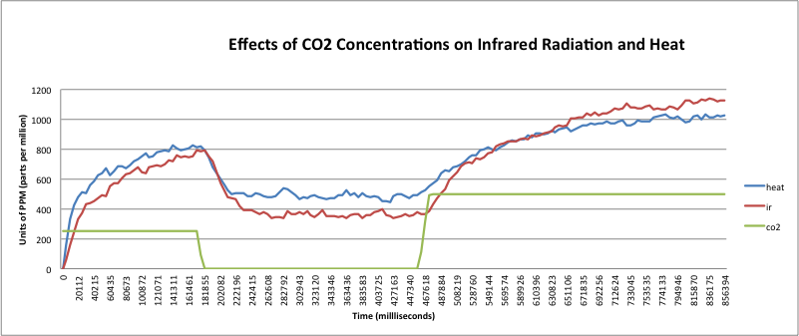
Students studied a problem-based WISE unit on climate change then went to the dome
Role-play, no narrative
They returned to class with data from their experiments
Modeling data surfaced many questions about relationships between variables
Notes:
Students took on scientist roles with specializations, proposing experiments to be conducted in ClimateDome to the lead scientist.
Overall, students learned.
However, adding role-play alone did not change participation structures here- those who tended to participate in class, participated, those who tended not to, didn’t.

Slide 10
Narrative
Provides coherence, context, situated experience, allows learners to construct meaning
(Bruner, 1991; Dede, 2009; Hazel, 2008)
Provides a motivating context for problem solving
(Dickey, 2006)
means to support struggling students
(Waraich & Brna, 2008)
Notes:
V

Slide 11
DomeStroids
Notes:
Nick: One of our co-authors worked with the computer scientists to develop and immersive, interactive activity called DomeStroids. He also designed a narrative context

Slide 12
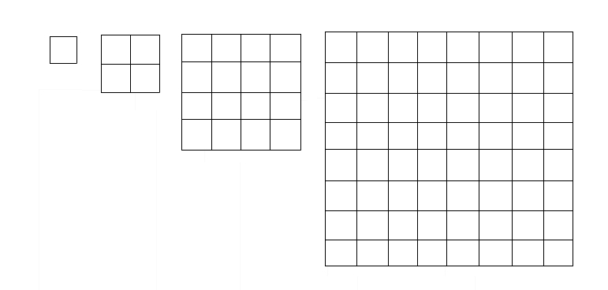
arithmetic and geometric sequences
narrative context: asteroids are headed to destroy earth, but a cancer researcher proposed a new weapon, based on cell division
each strike divides asteroid into 3 pieces, resulting in a sequence
topic has had low success rate in past
Notes:
Mr. D was willing to do this because he previously had a hard time teaching this topic, and he felt they only learned they were bad at math. He felt, even if they didn’t learn sequences, at least they would have fun with math

Slide 13
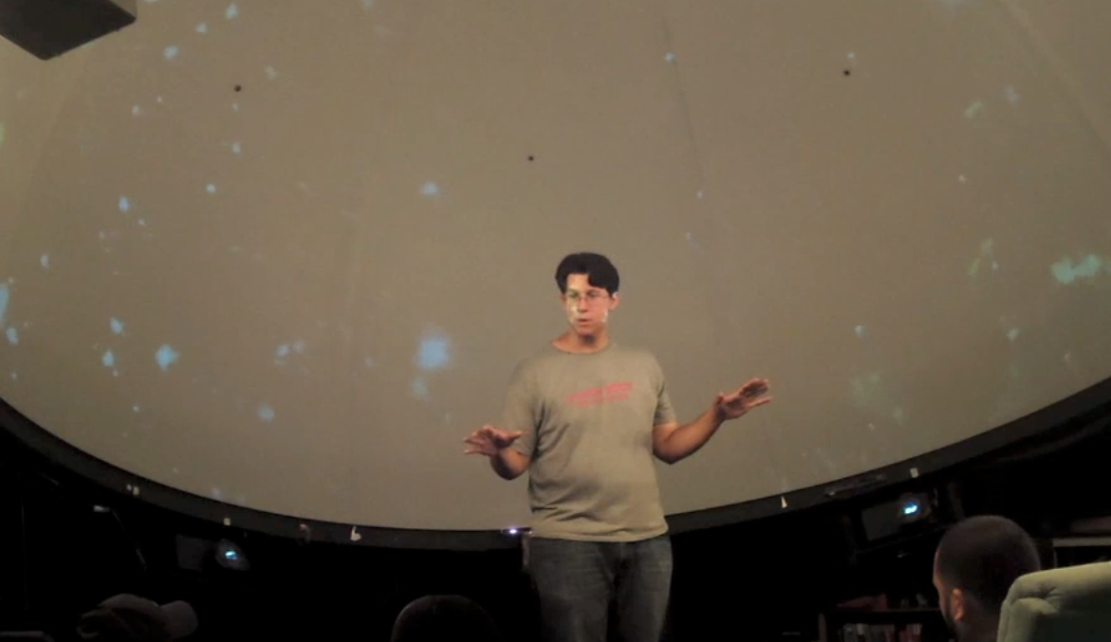
“We Can't Just Go Shooting Asteroids Like Space Cowboys”
Notes:
At first they spent some playful time blowing up asteroids! Mr. D tried to encourage them to stay focused on analyzing what was happening when the weapon hit an asteroid. He wanted to draw their attention to the pattern.

Slide 14
Mr. D: Wull:: ‘cause one became three right so actually we only added (.)
Ss: Two
Mr. D: Two more so how many did we have?
Ss: 22
Mr. D: 22. Okay and then we did it again. We fired again. How many did we have after that?
Ignacio: So would there be a formula- would be like uh the number of asteroids minus (.) minus one when it splits into three
Mr. D: You're getting kind of the right ide-. I'm not sure what you're saying
Ignacio: Minus one times two
Mr. D: No not times two //
Ignacio: //plus two
Mr. D: (.) You're almost there you're almost there. (.) Can anybody help him out. What do you guys think the formula for this thing should be?
Notes:
V: read transcript
Interpret: the last interaction is more representative of normal classroom practices- they engage in student-centered reasoning and proving activates
Ignacio led the class to find this formula. Afterwards, I asked the teacher if there were any surprises, he said YES, Ignacio had struggled, failed all semester and stopped participating in class. Mr. D was thrilled to see him emerge as a leader, and lead the class to derive a formula.

Slide 15
Clear understanding of sequences and pattern; includes entire formula for the number of asteroids as a function of the number of strikes by the weapon.
No understanding of sequences or pattern demonstrated; formula is absent or incorrect.
Missing important details about sequences or pattern but includes non-trivial explanation; reasoning unclear; formula is absent or incorrect.
Partial understanding of sequences and pattern; missing details; formula includes extraneous information or lacks explanation of reasoning
Notes:
Ignacio was not alone in being able to demonstrate his learning-

Slide 16
findings
ClimateDome
students engaged as scientists
surfaced questions
patterns of participation intact
DomeStroids
narrative context pervaded interactions
students learned sequences
invited participation from students who rarely participated

Slide 17
thanks! questions? vsvihla@unm.edu
This research is supported by an Interdisciplinary Research grant from the College of Education in cooperation with the Office of the Provost, University of New Mexico. Additional funding provided by the School of Engineering and the College of Fine Arts.
We also acknowledge prior NSF funding (PFI #917919) for the technology development.

