Slide 1
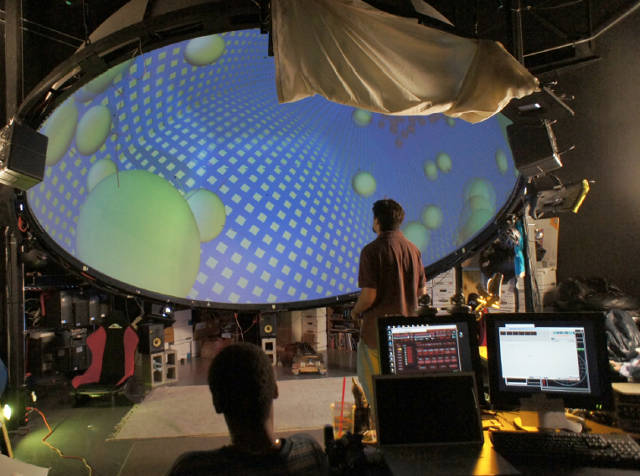
Supporting Practice, Integrating Research in Immersive Technologies into Educational Designs (SPIRITED): Teachers as designers
This research is supported by an Interdisciplinary Research grant from the College of Education in cooperation with the Office of the Provost, University of New Mexico
Vanessa Svihla, vsvihla@unm.edu
Joe Kniss, Eileen Waldschmidt, David Beining, Jonathan Strawn, Allison Hagerman,
University of New Mexico
6/3/2012
Notes:
Full dome: like a small planetarium. So what? Immersive, interactive (Wiimotes and pressure sensors), runs off one macbook pro, which is apparently revolutionary. Working toward affordable classroom based systems– three projectors, 1 laptop, IR cameras and a dark corner. This opens up some exciting possibilities, but we don’t know much about learning with these media,

Slide 2
how might teachers plan to incorporate immersive, interactive projection into their designs?
teachers struggle to think like designers (Reiser et al., 2000)
authenticity and iteration help (Koehler & Mishra, 2005a, 2005b; Koehler et al., 2004)
design principles help (Bybee, 1997; Edelson, 2001; Schwarz & Gwekwerere, 2007)
providing curricula to adapt + PD can help (Ball & Cohen, 1996; Connelly & Clandinin, 1988; Davis & Krajcik, 2005; Fishman, Marx, Best, & Tal, 2003; Schneider & Krajcik, 2002).

Slide 3
Design Dimension | Components
Design occurs under constraints. | Cost Regulations
Design involves form and function. A customer may select a design based on form, even if function is inferior. | Materials Style Ambiguity
Designs address diverse customer or client needs, some of which may be implicit. | Roles Needs Implicit/False
Design is an iterative process that requires evaluation and optimization across tradeoffs. | Tradeoffs Improvement Coevolution
interdisciplinary project-based learning course, in-service teachers (n=9)
design tools: VOC, ideation, evaluation, prototyping
data: reflections, artifacts, pre/post tests

