Slide 1
Supporting Practice, Integrating Research in Immersive Technologies into Educational Designs (SPIRITED): Technology to Support Co-located Collaborative Learning
Vanessa Svihla, vsvihla@unm.edu
Joe Kniss, Eileen Waldschmidt, David Beining, Jonathan Strawn, Allison Hagerman, Matt Dahlgren, and Nichols Kvam and Jeffrey Bowles
University of New Mexico
6/2/2012
Notes:
Authors will have up to 10 minutes time for a short presentation of their work and 5 minutes for questions. The format of the talk is free and you can use alternative ways to present it.
A second option is to present a video of up to 5 minutes during the Video session.
A third option is to present both. Just let me know how do you want to present.
Full dome: like a small planetarium. So what? Immersive, interactive (Wiimotes and pressure sensors), runs off one macbook pro, which is apparently revolutionary. Working toward affordable classroom based systems– three projectors, 1 laptop, IR cameras and a dark corner. This opens up some exciting possibilities, but we don’t know much about learning with these media,

Slide 2
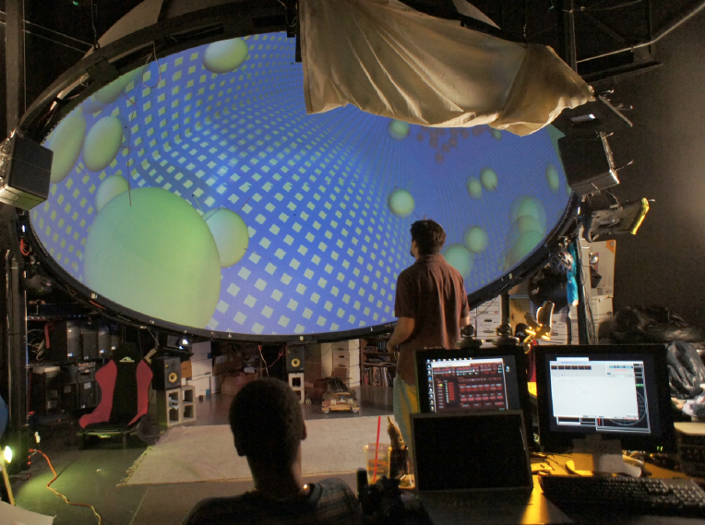

Slide 4
questions we are exploring
How might we support teachers to design and implement inquiry in which context is provided and scientific activity structures are provoked using immersive, interactive technology?
In what ways might an immersive experience reconfigure inquiry learning, before, during, and after the experience?

Slide 5
Pilot studies
mathematics for elementary teachers
topic selected has had low success rate in past
n=9
greenhouse effect
in development
exploring feasibility of turning a netlogo simulation into a 3D model
nature of science, with pre-service secondary science teachers

Slide 6
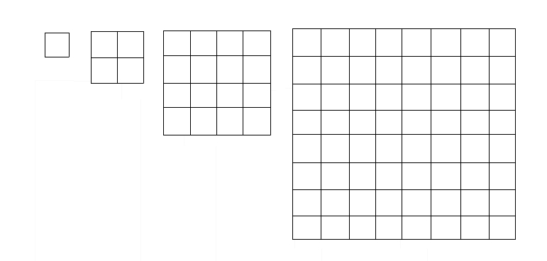
arithmetic and geometric sequences with domestroids
context: cancer researcher proposes new weapon design to destroy asteroids, based on ideas of sequences
number of asteroids
size of asteroids

Slide 7
Methods
interdisciplinary design team
video records
low light conditions in dome
interaction analysis
artifacts
grounded coding
pre/post comparisons
interviews

Slide 8
ways forward
low-cost immersive, interactive projection kits for use in classrooms
exploring how our designs might fit into classrooms to reconfigure learning, transforming corners of classrooms into interactive rings of Saturn or carbon nanotubes.

Slide 9
feedback desired
what are the affordances of this immersive, interactive environment?
how do they differ from other similar environments?
how are we (not) taking advantage of them?
what are we not asking, that we should be asking?
Notes:
----- Meeting Notes (7/2/12 09:24) -----
back light in central-- 360camera
avoid using teachers as designers--change this in
get this built and study it
kinects might be better

Slide 10
thanks
This research is supported by an Interdisciplinary Research grant from the College of Education in cooperation with the Office of the Provost, University of New Mexico. We also acknowledge prior NSF funding (PFI #917919) for the technology development, though the views presented are our own.

Slide 11
Design Dimension | Components
Design occurs under constraints. | Cost Regulations
Design involves form and function. A customer may select a design based on form, even if function is inferior. | Materials Style Ambiguity
Designs address diverse customer or client needs, some of which may be implicit. | Roles Needs Implicit/False
Design is an iterative process that requires evaluation and optimization across tradeoffs. | Tradeoffs Improvement Coevolution
interdisciplinary project-based learning course, in-service teachers (n=9)
design tools: VOC, ideation, evaluation, prototyping
data: reflections, artifacts, pre/post tests

